Slide 1
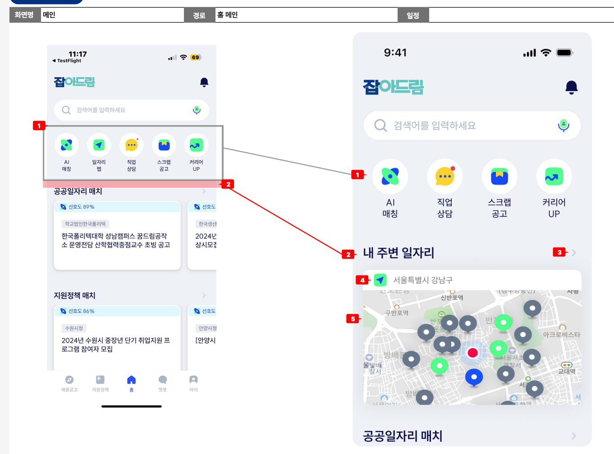
[APP] Main
1.quick menu button (no 1) - REMOVE 일자리 맵 (job map) button
- adjust width ratio of remaining 4 button
2.내 주변 일자리 (my near job) (no 2)
- add this new area
1) current location address text (no 4)
- use 일자리 맵 icon (24*24) - display current address (but show until district of current city)
2) map with job marker (no 5)
- reuse map of 일자리 맵 (job map) page
- if tab map area, move to 일자리 맵 (job map) page
3) exception process
a) if 위치정보 동의 (current location agreement) is not agreed on App a-1) show address text: “위치정보 추적권한 동의가 필요합니다.” a-2) map : show with default address (“경기 수원시 영통구 도청로 30“)
a-3) alert current location agreement
3.> button (no 3)
- if clicks, move to 일자리 맵 (job map) page
4.design
- refer to Figma link
[APP] 위치정보 동의 (current location agreement)
1.As-is
- when access 일자리 맵 (job map) page
2.To-be
- when access Home page on App

