Slide 1
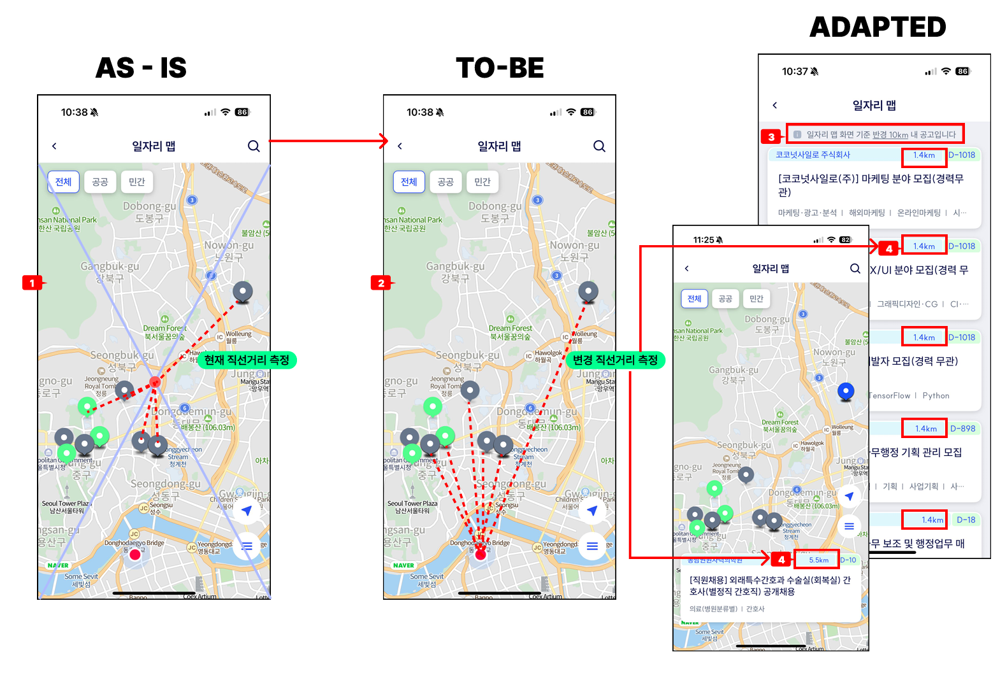
[APP] 일자리 맵 (job map)
1.if current GPS location is activated
1) get job list with URL - URL: [API] POST /api/jobInfoMapList a) new parameter "currMapLat“ : set by current location lat
"currMapLng“ : set by current location lng

Slide 2
[APP] 일자리 맵 (job map)
2.when 일자리 맵 > search button clicks
1) if address is searched and selected
a) get job list with URL - URL: [API] POST /api/jobInfoMapList
+ same with previous API + don’t set new parameter (currMapLat/ currMapLng)

