Slide 1
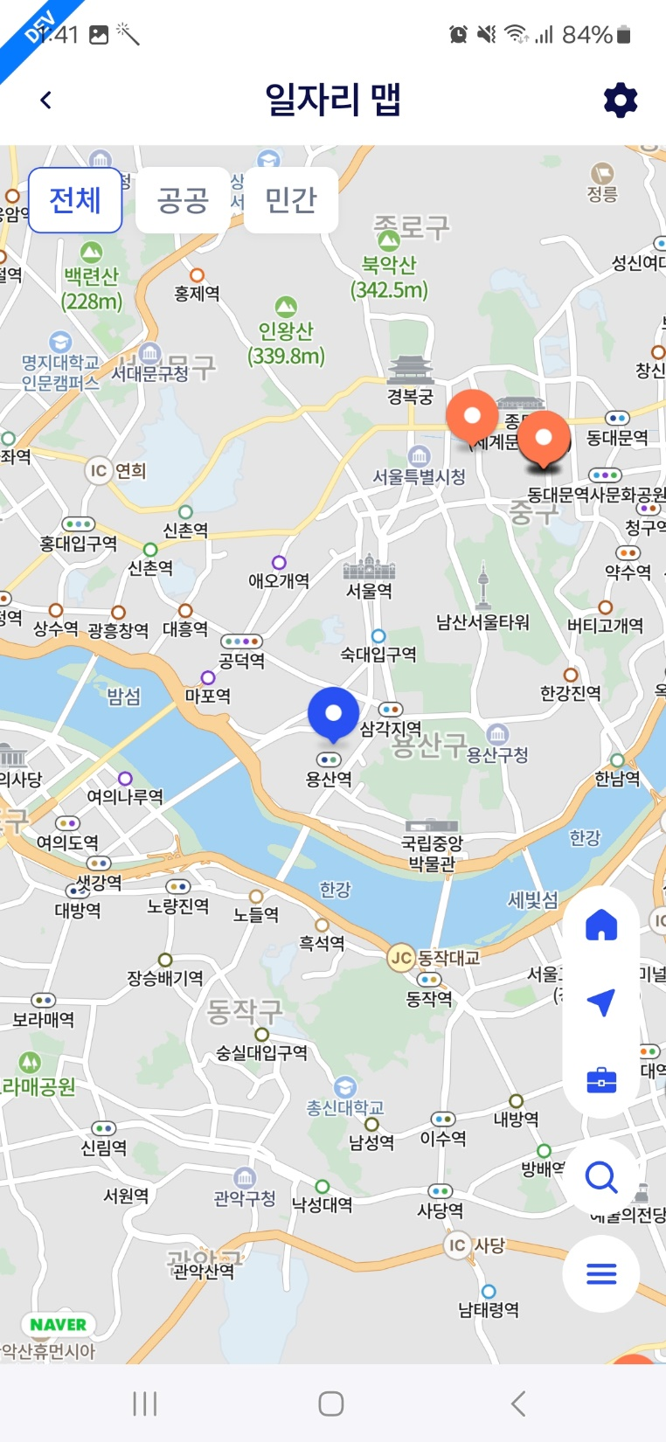
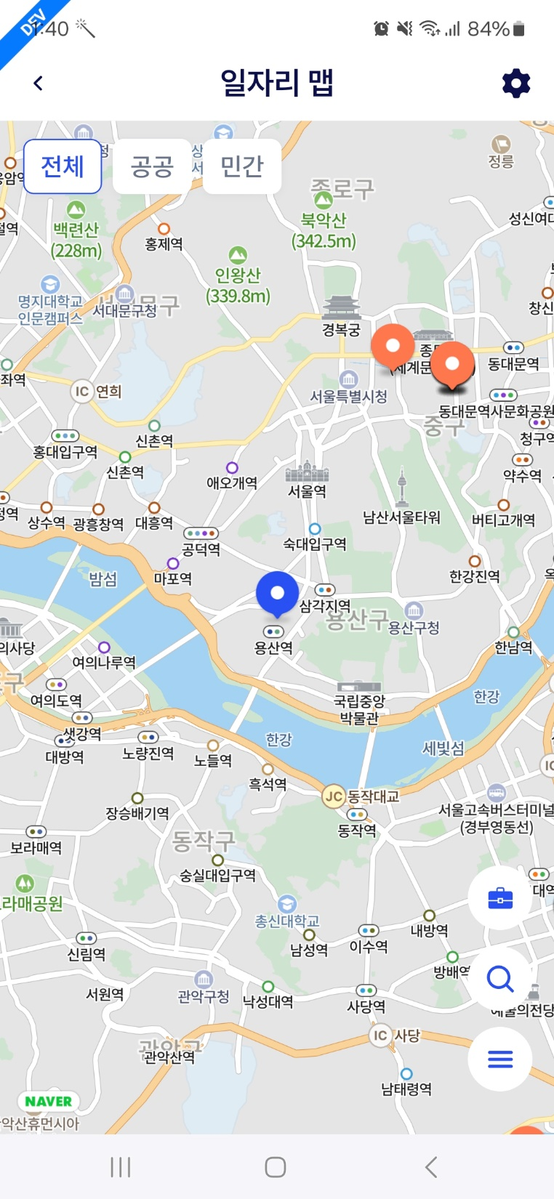
[APP] 일자리 맵 (job map)
1.steps
- home/office icon clicks -> move map to the address
- job list icon clicks
2.error
1) when show job list
- GPS location is NOT changed with selected home/office location
ㅍ

