Slide 1
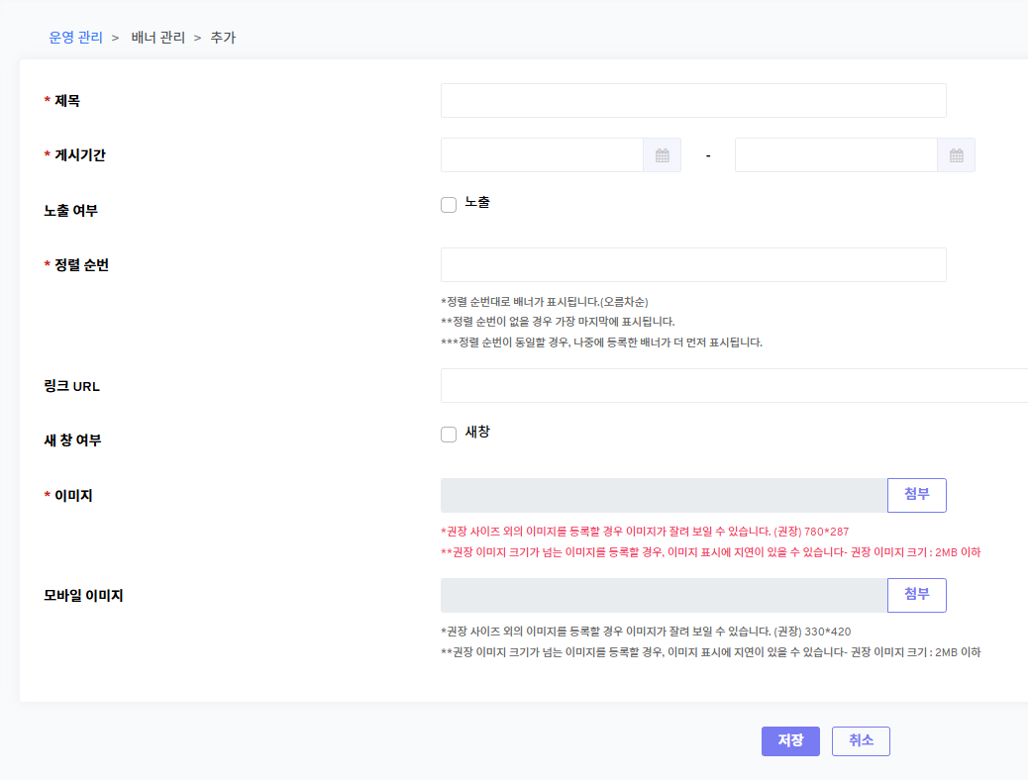
Color: rgb(104, 104, 104)로 수정
아래와 동일
AS IS: 780*287
TO BE: 1500*600
AS IS: 330*420
TO BE: 700*700

Slide 2
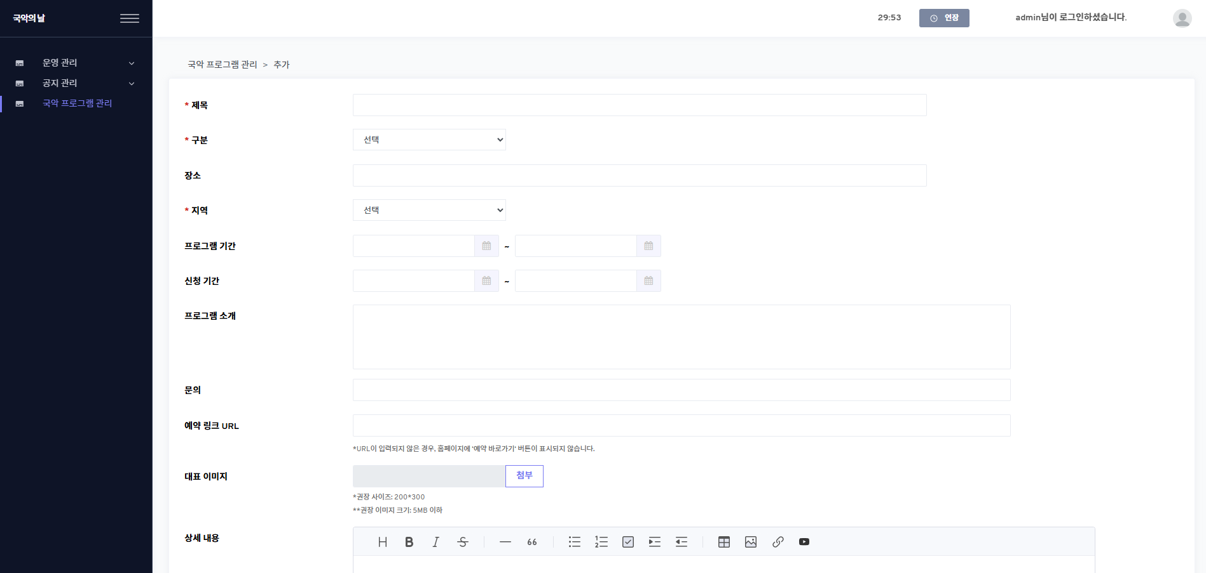
AS IS: 200*300
TO BE: 540*714

