Slide 1
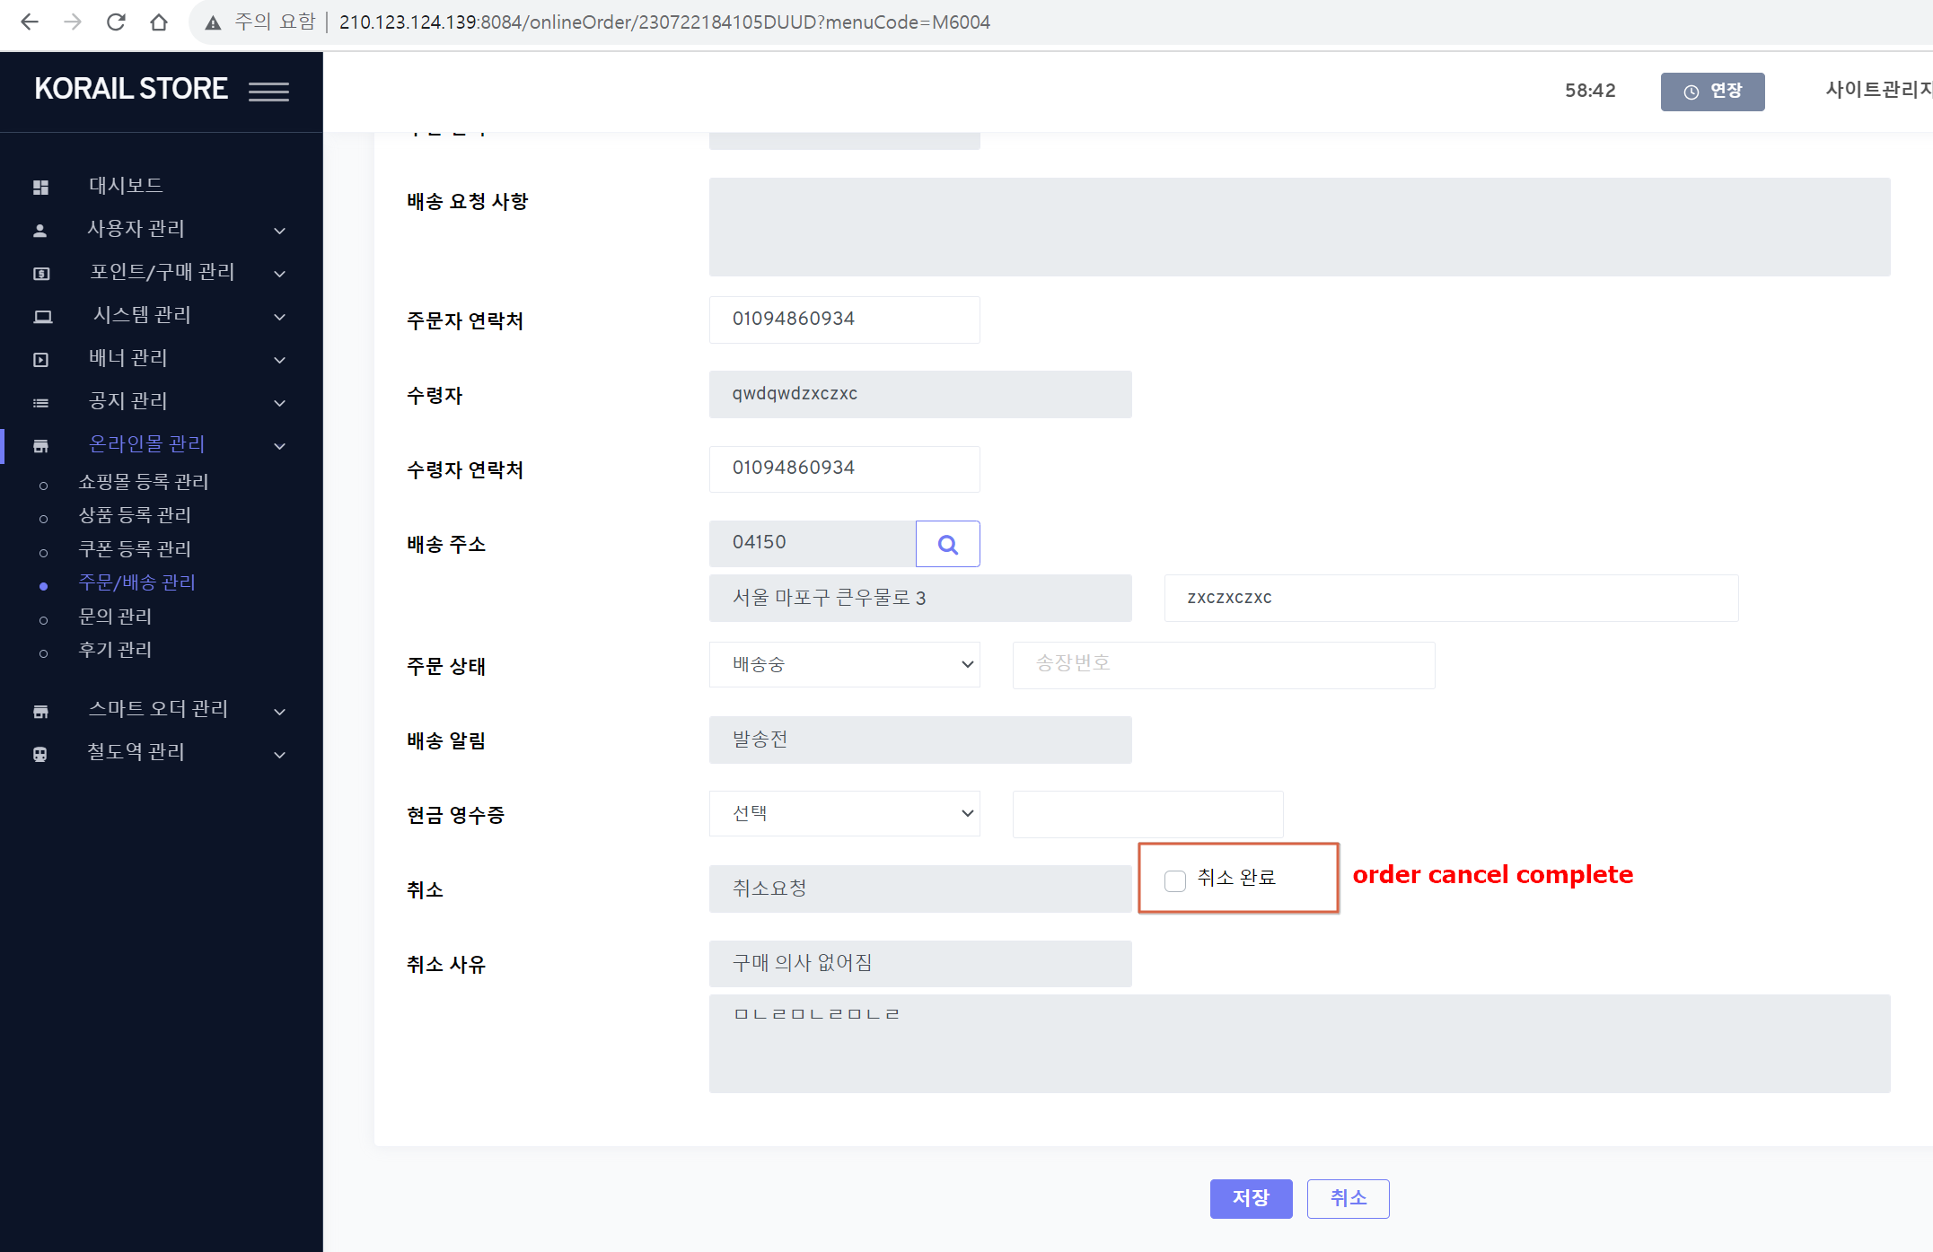
1.Menu navigation
온라인몰 관리 > 주문/배송 관리 (/onlineOrder) > 상세 (Modify)
2.저장(save) button
1) if 취소 완료 (order cancel complete) is checked and Saved
- currently, st_order.claim_status is updated (‘CS10’ -> ‘CS11’)
- change the process logic like 2)
2) process logic (change)
a) call [Common] PG payment cancellation (결제취소) function (issue #79 – No 3)
a-1) paramters
- order no : current order_no - user_seq : login admin user_seq - cancel reason: {claim_reason_type}’s code name (code: CR)
b) if a) PG payment cancel is fail - return and alert error msg.(“PG 결제취소중 에러가 발생했습니다.({pg_error_code} {pg_error_msg})”
c) if a) PG payment cancel is success
c-1) call [Common] order's product stock count process (issue #78 – No 2-3))
- but st_order_product.order_count is plus(+) into st_product.stock_count bcz product is returned
c-2) UPDATE st_order - same with previous

Slide 2
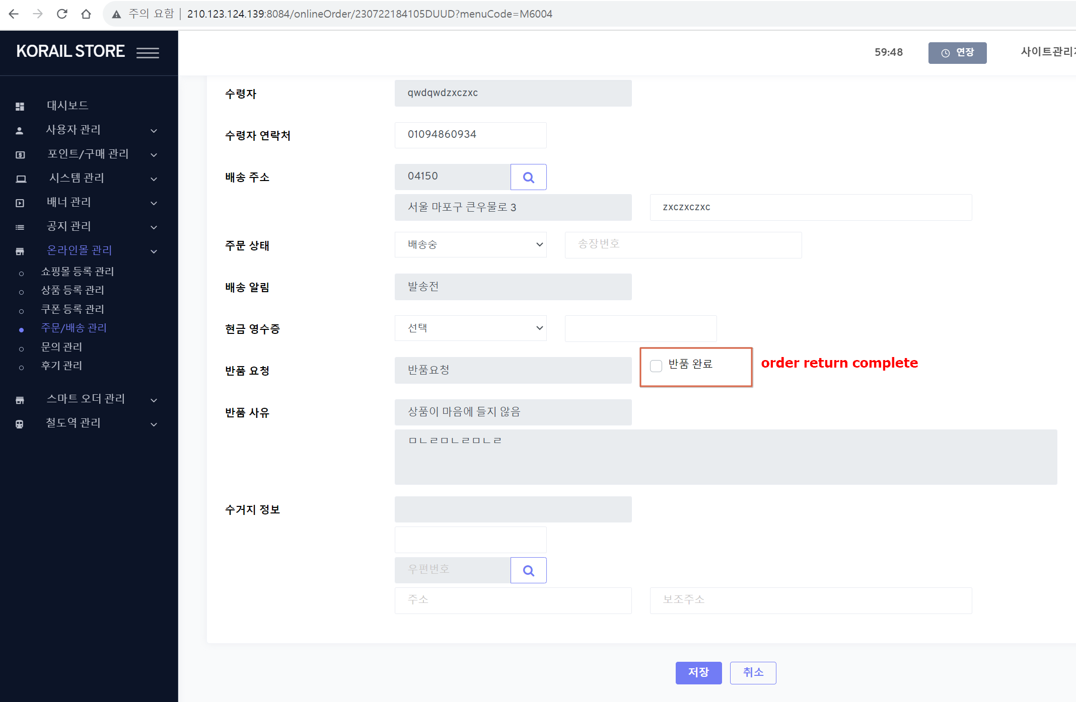
1.Menu navigation
온라인몰 관리 > 주문/배송 관리 (/onlineOrder) > 상세 (Modify)
2.저장(save) button
1) if 반품 완료 (order return complete) is checked and Saved
- currently, st_order.claim_status is updated (‘CS20’ -> ‘CS21’)
- change the process logic like 2)
2) process logic (change)
- same with p1 > No 2-2)

Slide 3
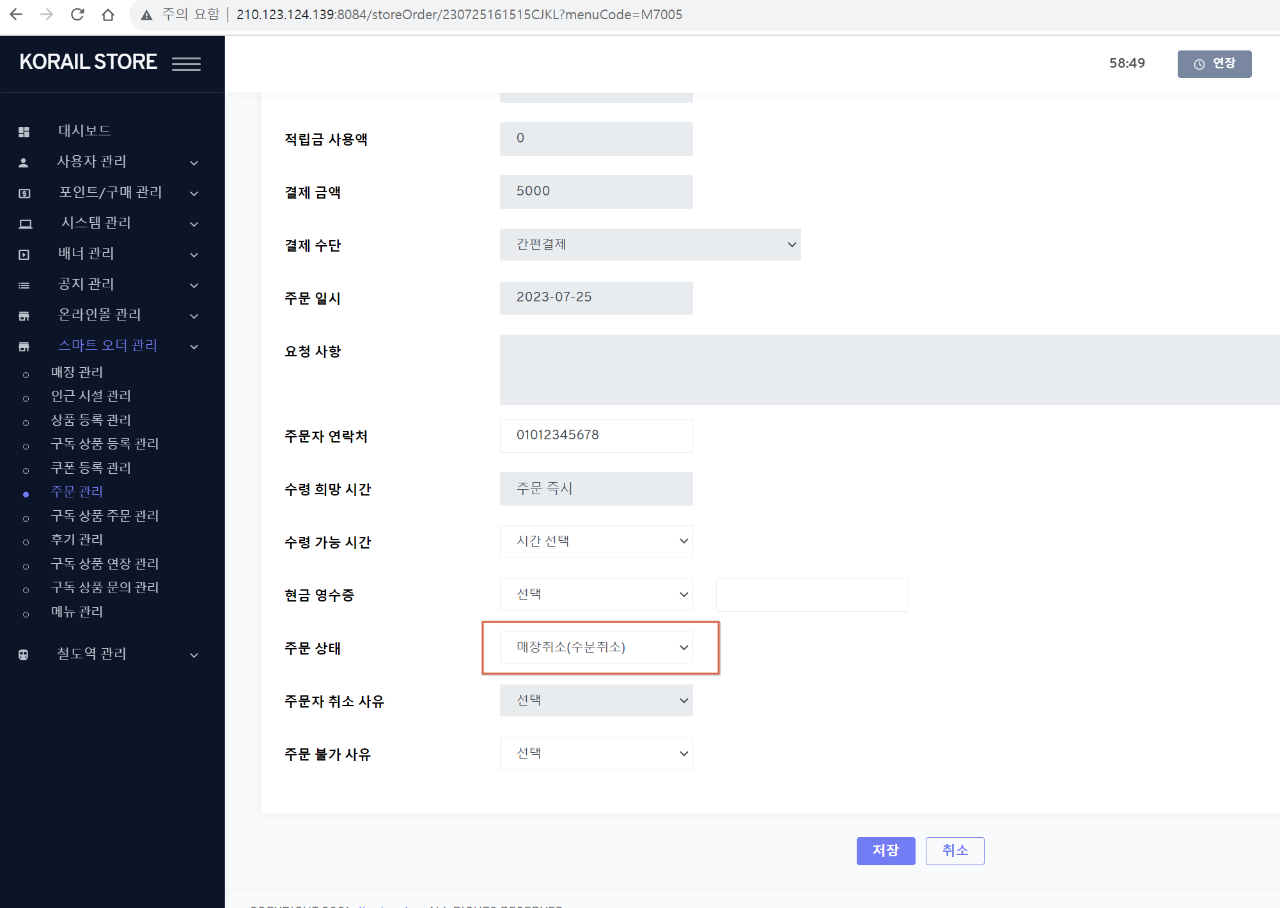
1.Menu navigation
스마트 오더 관리 > 주문 관리 (/storeOrder) > 상세 (Modify)
2.Fields
1) 주문 상태 (smart_order_status)
- if smart_order_status = ‘SS05’ (주문자취소(주문취소)) or ‘SS10’ (매장취소(주문취소)), disable it (it not, enable it)
3.저장(save) button
1) if 주문 상태 is changed with ‘SS10’ (매장취소(주문취소)) and Saved
- change the process logic like 2)
2) process logic (change)
a) call [Common] PG payment cancellation (결제취소) function (issue #79 – No 3)
a-1) paramters
- order no : current order_no - user_seq : login admin user_seq - cancel reason: selected 주문 불가 사유 field {reject_reason_type}’s code name (code: SC)
b) if a) PG payment cancel is fail - return and alert error msg.(“PG 결제취소중 에러가 발생했습니다.({pg_error_code} {pg_error_msg})”
c) if a) PG payment cancel is success
c-1) UPDATE st_order - same with previous

