Slide 1
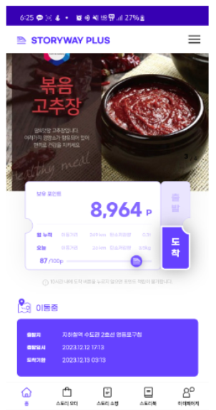
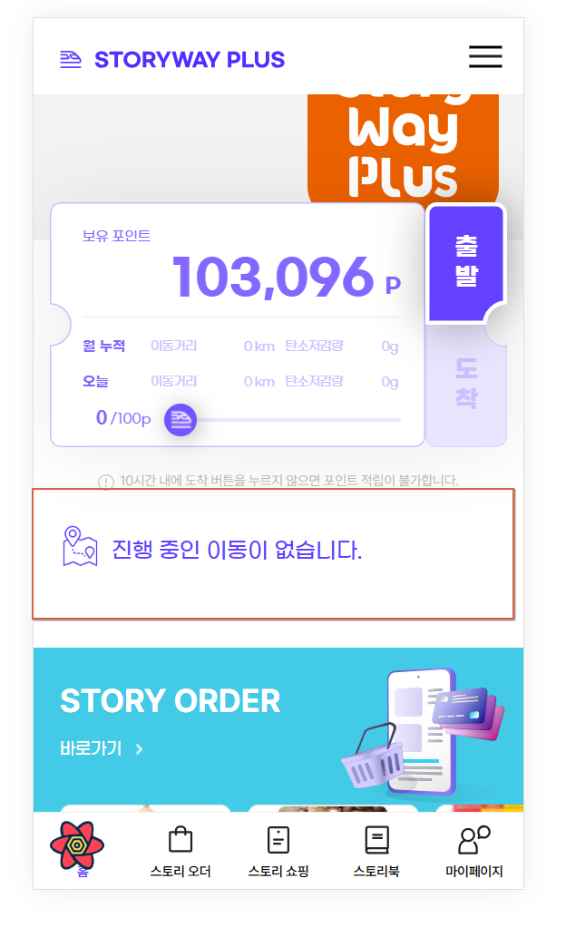
[APP] Main
1.if user has no latest station depart (출발)
2.if user has latest station depart (출발)
[APP] Main
1.station depart (출발) area
1) logic to check if latest depart exists
a) As-is
- local storage is used
b) To-be
- don’t use local storage
- call [API] GET /api/point_station_start
2) depart (출발) info area
a) if API is no response data
- “진행 중인 이동이 없습니다.” (No 1) as current
b) if API has response data
- show depart info (No 2) as current
2.출발 (depart) button
1) if API has no response data
- can select
- disable 도착(arrive) button (can’t click)
3.도착 (arrive) button
1) if API has response data
- can select
- disable 출발(depart) button (can’t click)
[API] GET /api/point_station_start
1
2

Slide 2
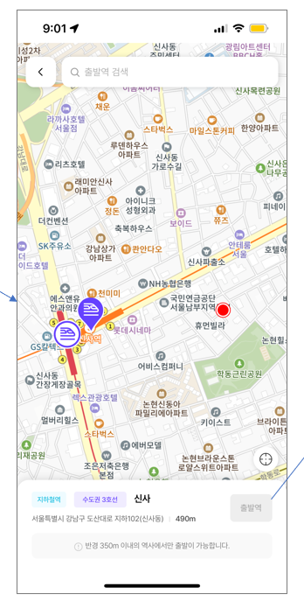
[APP] Main > Select 출발(depart) station
[APP] Main > Select 출발(depart) station
1.Map
- on mobile app, map is displayed in Korea with GPS location
- currently, map is not shown overseas
- so, use hard-code GPS location (37.5552, 126.9733) to show map for test
2.출발역 (depart station) button on bottom
1) if clicks after select station on map
a) [API] POST /api/point_station_start is called

Slide 3
[APP] Main > Select 도착(arrive) station
[APP] Main > Select 도착(arrive) station
1.when move from Main to arrive page
- keep {depart_station_seq} of [API] GET /api/point_station_start response
2.Map
- on mobile app, map is displayed in Korea with GPS location
- currently, map is not shown overseas
- so, use hard-code GPS location (37.51459, 126.9083) to show map for test
3.도착역 (arrive station) button on bottom
1) if clicks after select station on map
a) [API] POST /api/save_point is called
- apply change into react: /lib/api

