Slide 1
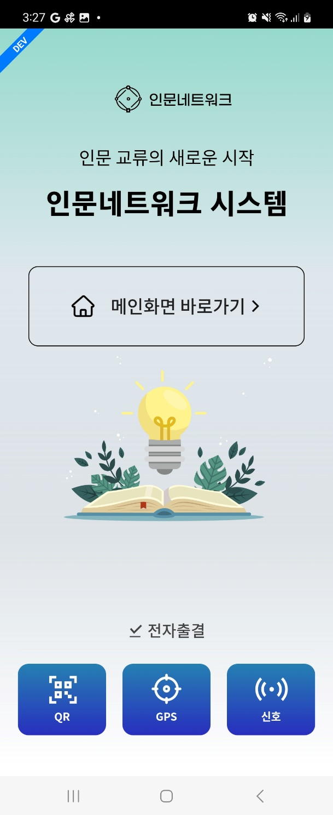
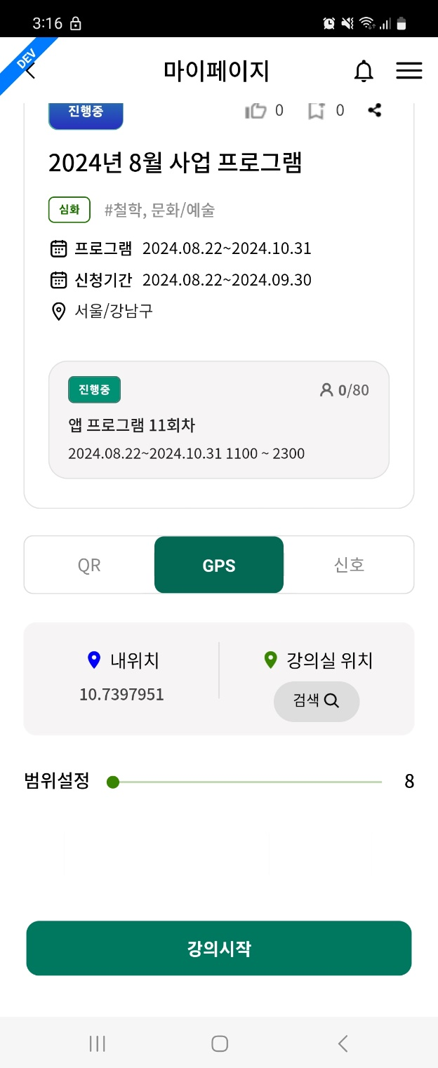
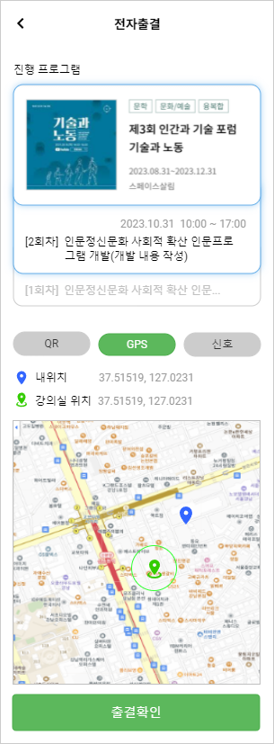
[APP] 전자출결 (Electronic Attendance) > GPS
1.Test 1) Steps
- login : test11/qwer12!@
- GPS button clicks
2) Test case
a) INMUN_PRO.PRO_SEQ=600 PRO_NM=2024년 8월 사업 프로그램
b) INMUN_FACI.FACI_SEQ=67010099
FACI_NM=강남구립 논현정보도서관
2.GPS attend page
1) 내위치 (my location)
- I tested APP using Fake GPS. but location value is not changed
- check if current location(lat/long) is displayed correctly
2) 강의실 위치 (lecture facility location)
a) GPS location
- fix why {classLocation.lat} is not displayed (source: GpsAttend/index.js)
3) Map
- display 내위치 (my location) mark
- display 강의실 (lecture facility) mark (green color) and circle on the map (currently, lecture facility mark is not displayed)
1
2
[Spec]
3

Slide 2
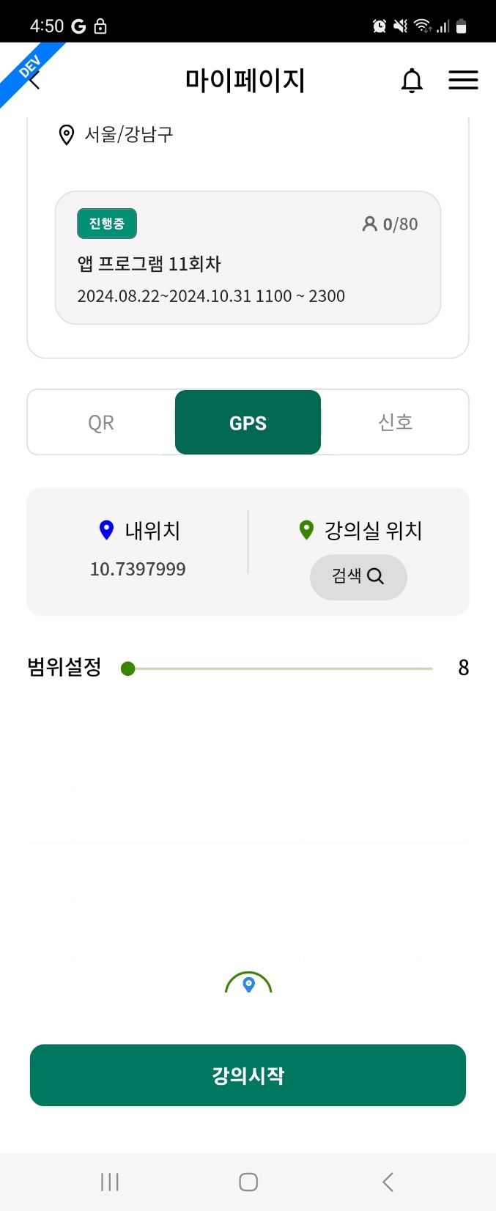
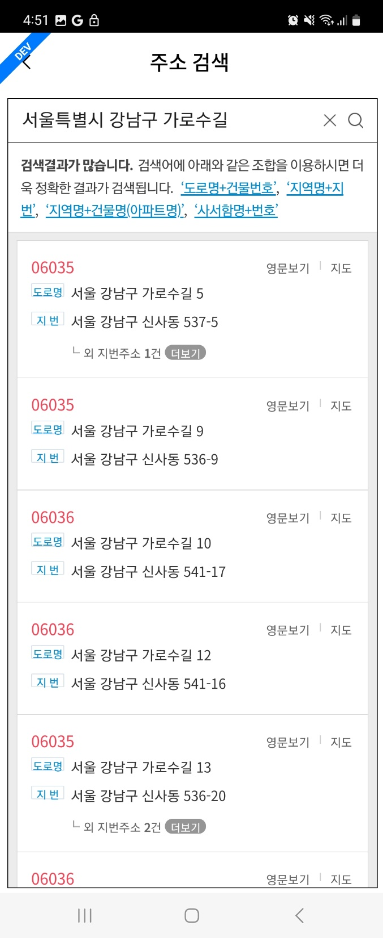
[APP] 전자출결 (Electronic Attendance) > GPS
1.강의실(lecture facility) > 검색 (search) button
- move to 주소 검색 (search address) page
2.주소 검색 (search address)
1) if address is selected
- return page with GPS location of selected address
(currently, no action)
a) 강의실 위치
- show GPS location with selected address
b) map
- same with p1 > 2-3) - but 강의실 (lecture facility) mark & circle is displayed with selected address

