Slide 1
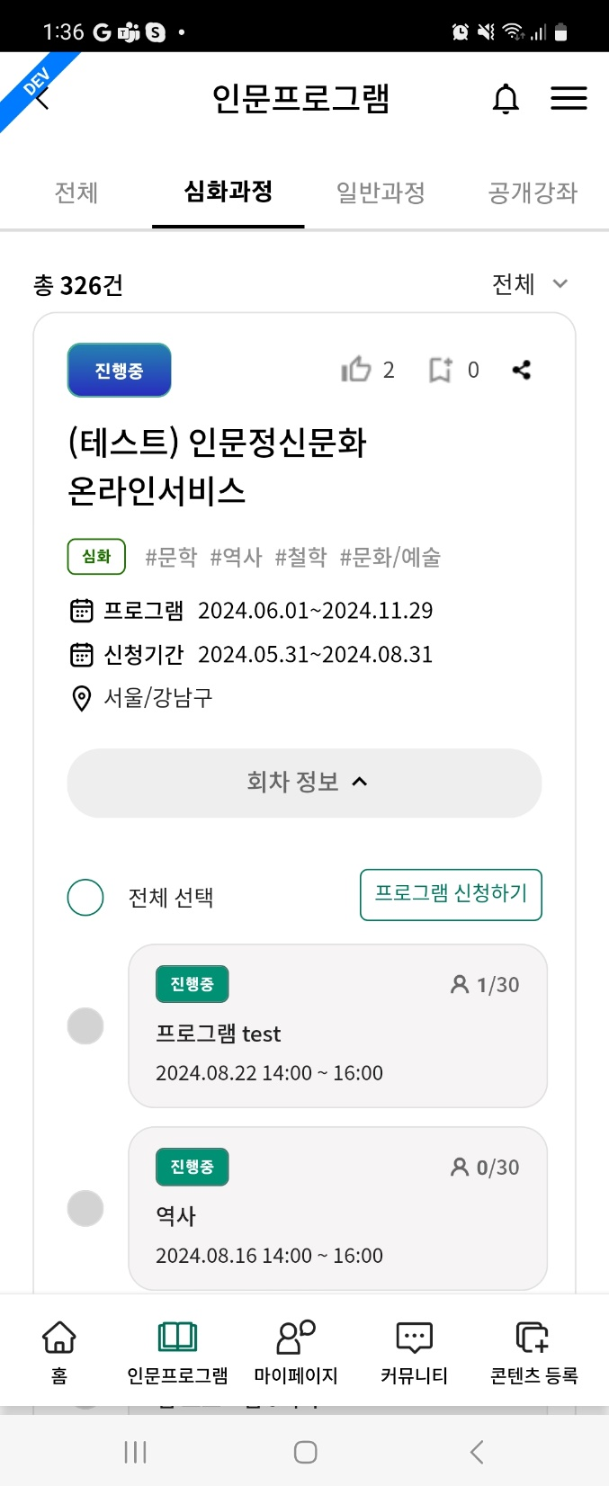
[APP] 인문프로그램 > 심화과정 / 일반과정 program
1.프로그램 신청하기 (apply program) button
1) if there’s no selectable course
- alert msg.(“신청 가능한 회차가 없습니다. 일정을 확인해주세요.“)
2.if the program course(회차) is already applied
1) As-is
- checkbox is disabled
- currently, if can’t select course because of apply period, checkbox is also disabled.
2) To-be
- checkbox should be checked & disabled
1
2

